Slide 1



Presenting…….
A Project
On
Online Restaurant Menu
Notes:
To view this presentation, first, turn up your volume and second, launch the self-running slide show.

Slide 2

Presented By,
Sumaiya Tabassum Kona ID: 15162103032
Nura Alahi Sagor ID: 15162103008
Sadika Haque ID: 15162103005
Submitted to,
Saifur Rahman Dipu
Notes:
To view this presentation, first, turn up your volume and second, launch the self-running slide show.

Slide 3
Contents:
Introduction
About the project
Algorithm
Topics of the project
Conclusion

Slide 4
Introduction:
The project is about an online restaurant menu where customers can order food items sitting in their homes and is a very easy way to order foods immediately.

Slide 5
About…
An online restaurant menu where customers can order a specific number of dishes.
The menu section is divided into three different menus such as breakfast, lunch and dinner.

Slide 6
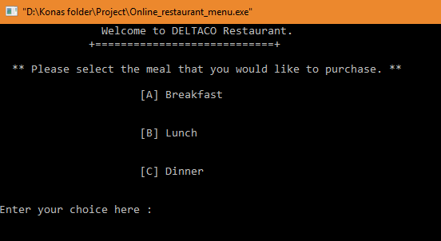
The way the sections are divided..

Slide 7
Selecting these menus, there will appear a list of food items.
In the list, the dishes are arranged serially with proper price.

Slide 8
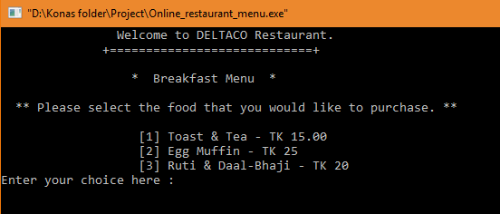
Just as the way it is shown here!

Slide 9
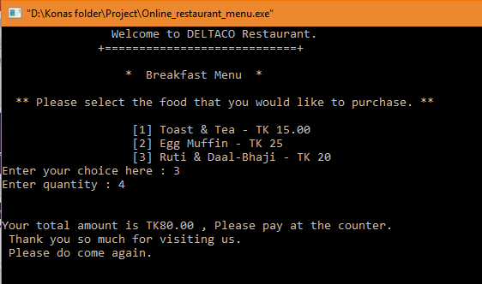
There’s also an option for quantity where customers can order how many of a food item is needed.
After finishing orders, the prices are going to be added automatically.

Slide 10
Algorithm….
Step 1: Start
Step 2: Declare void functions bfast(), lunch(), dinner(), m_m(), exit().
Step 3: Declare integer variables num, again, floating variables price, total and character variable choice.
Step 4: Declare character variable choice in m_m() function
Step 1: Start
Step 2: Declare void functions bfast(), lunch(), dinner(), m_m(), exit().
Step 3: Declare integer variables num, again, floating variables price, total and character variable choice.
Step 4: Declare character variable choice in m_m() function

Slide 11
Step 5: If choice==A
print breakfast menu
else if choice==B
print lunch menu
else if choice==C
print dinner menu
else if choice!=A, B, C
go back to menu
Step 6: Declare variables choice, quantity, again in bfast() function

Slide 12
Step 7: Initialize variables
choice = 0
quantity = 0
again = 0
Step 8: If choice==1
print enter quantity, total, would you like to buy anything else 1.Yes or 2.No
Step 9: If again==1
go back to bfast() function
else if again==2
go back to m_m() function
else if again!== 1, 2
print sorry invalid decision entered

Slide 13
Step 10: Else if choice==2
repeat step 9 again
Step 11: Else if choice==3
repeat step 9 again
Step 12: Declare variables choice, quantity, again in lunch() function
Step 13: Repeat step 7 to 11 again
Step 14: Declare variables choice, quantity, again in dinner() function
Step 15: Repeat step 7 to 11 again
Step 16: Stop

Slide 14
Topics…….
The program has been done using file function.
The user of this program is an employee taking an order from a customer.
Each time the program runs, it takes a single customer’s order.
Prints a welcome message that the user can read to the customer.
Prints a menu of the items that can be ordered.

Slide 15
Each time a new item is added to the customers order, the current total price is printed.
When the customer doesn’t want to order any more items, the user enters an item that indicates the customer is done.
The price is presented in taka.
Prints a nice message for the user when the customers are done ordering and the total price.
The program exists.

Slide 16
Conclusion….
Above all, we can say that the online service for ordering food items is very useful in our daily life.
It makes our life easier than before.
It is also very helpful in immediate cases.
All over it is a good service.

Slide 17
THANK YOU

